Slide 1
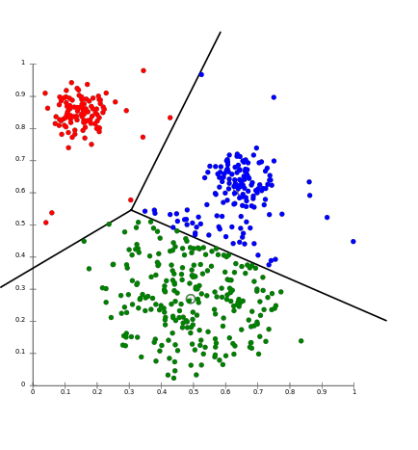
K-means clustering – Project proposal
Marzia Matejcek, Leonie Gerling,
Annika Wehrle, Ege Bayraktar

Slide 2
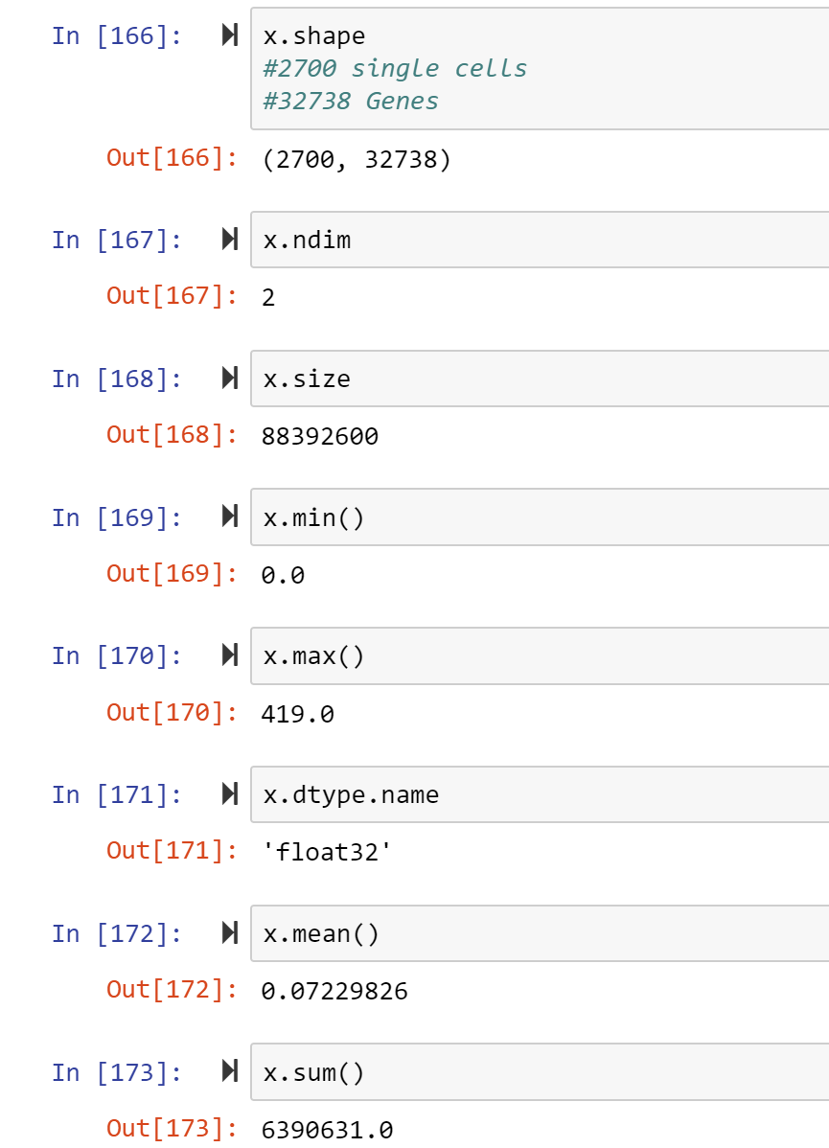
Data exploration

Slide 3
Cell Type | Markers
Naive CD4+ T | IL7R, CCR7
Memory CD4+ | IL7R, S100A4
CD14+ Mono | CD14, LYZ
B | MS4A1
CD8+ T | CD8A
FCGR3A+ Mono | FCGR3A, MS4A7
NK | GNLY, NKG7
DC | FCER1A, CST3
Platelet | PPBP

Slide 4
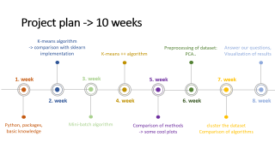

Project plan -> 10 weeks
K-means algorithm
-> comparison with sklearn implementation
1. week
2. week
Python, packages, basic knowledge

Slide 5
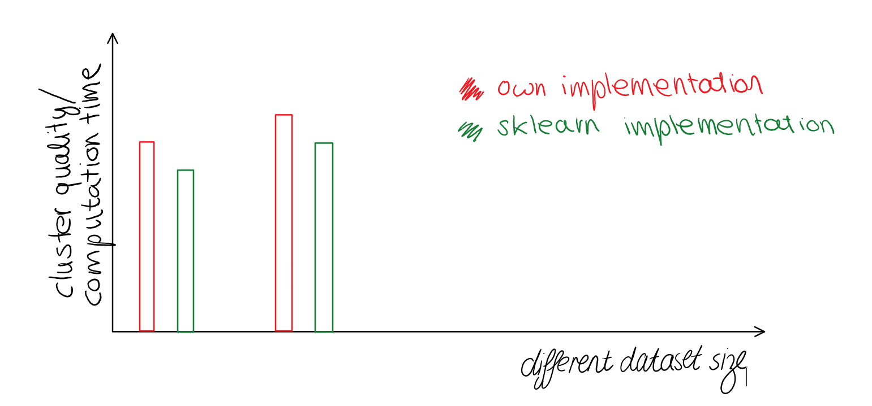
Tabels for different datasets with various sizes:
Multiple plots for visualization:
e.g. :
k | Average sum of squared distance Algorithm sklearn implementation |  | Minimum - “ - |  | Average T (computation time)
i.e. 10
25
50

Slide 6
Project plan -> 10 weeks
K-means algorithm
-> comparison with sklearn implementation
Preprocessing of dataset: PCA..
Answer our questions,
Visualization of results
K-means ++ algorithm
1. week
3. week
5. week
7. week
2. week
4. week
6. week
8. week
Python, packages, basic knowledge
Mini-batch algorithm
Comparison of methods -> some cool plots
cluster the dataset
Comparison of algorithms

Slide 7
A few questions
Which algorithm for which type/ size of data?
Limits of several algorithms?
What could we predict if we clustered the data?

Slide 8
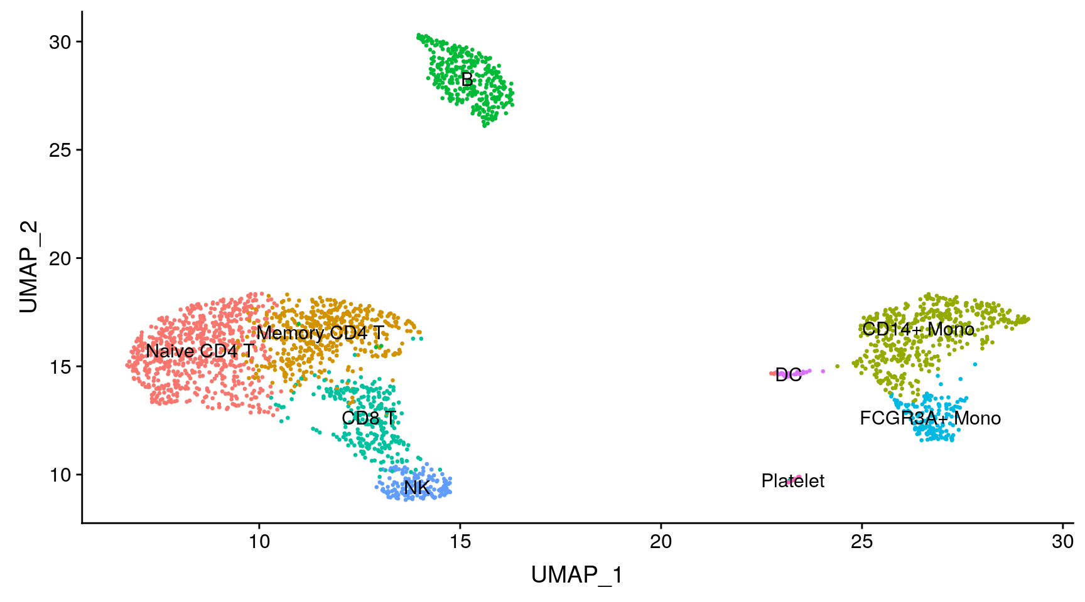
Goal…

Slide 9
Questions
Can we find clusters that show only one type of cell?
→ find marker genes
Which genes are expressed the most by which cell type?
How homogenous/heterogenous is the population?
Can we use the cluster pattern (of other patients) to predict/diagnose diseases?

